Slide 1
1. What is Phase kickback?

Slide 2

Global phase & relative phase
Consider state $\left.|φ\right\rangle =c_{1}\left.|0\right\rangle +c_{2}\left.|1\right\rangle =r_{1}e^{iφ_{1}}\left.|0\right\rangle +r_{2}e^{iφ_{2}}\left.|1\right\rangle$
$$=e^{iφ_{1}}(\left.r_{1}|0\right\rangle +r_{2}e^{i\left(φ_{2}−φ_{1}\right)}\left.|1\right\rangle )$$
$e^{iφ_{1}}$ is vanish while conduct the measurement ${|\left\langle φ | φ\right\rangle |}^{2}$

Slide 3
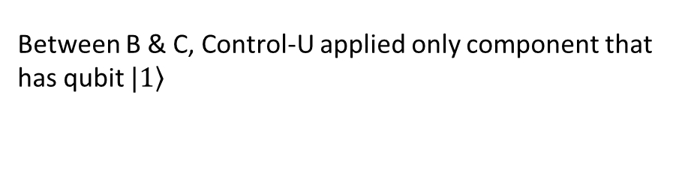
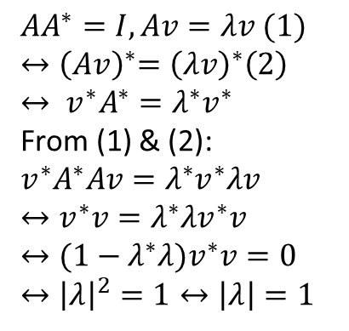
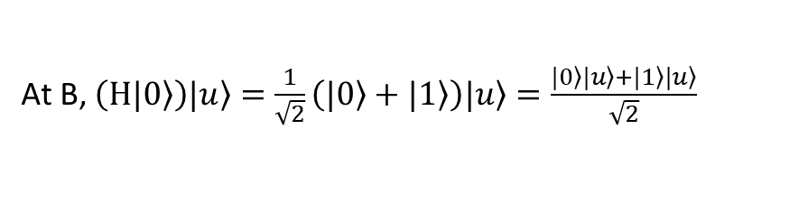
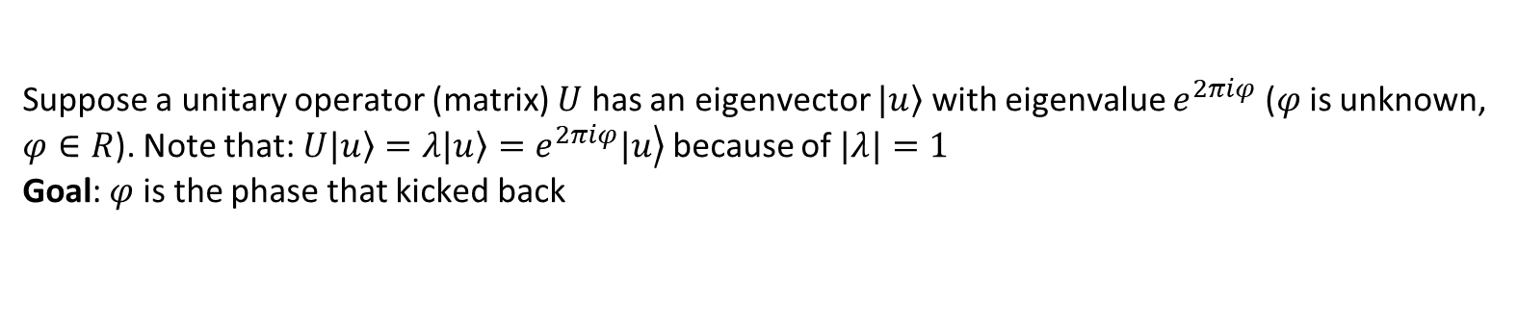
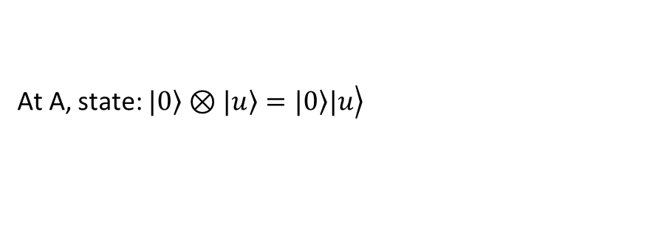
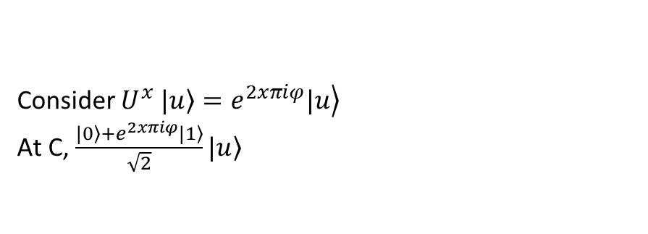
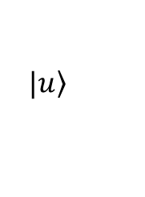
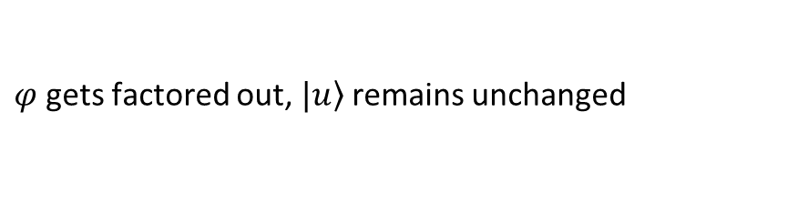
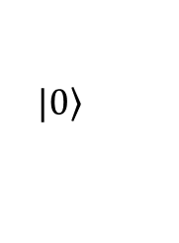
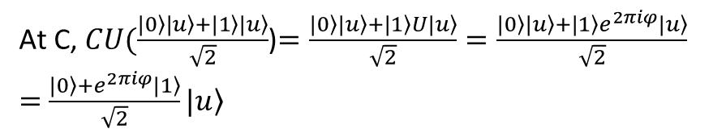
Suppose a unitary operator (matrix) $U$ has an eigenvector $\left.|u\right\rangle$ with eigenvalue $e^{2πiφ}$ ($φ$ is unknown, $φ∈R$). Note that: $U\left.|u\right\rangle =λ\left.|u\right\rangle =\left.e^{2πiφ}|u\right\rangle$ because of $|λ|=1$
Goal: $φ$ is the phase that kicked back
$$AA^{∗}=I, Av=λv (1)$$
$${↔\left(Av\right)}^{∗}={\left(λv\right)}^{∗}\left(2\right)$$
$$↔ {v^{∗}A}^{∗}=λ^{∗}v^{∗}$$
From (1) & (2):
$${v^{∗}A}^{∗}Av=λ^{∗}v^{∗}λv$$
$$↔v^{∗}v=λ^{∗}λv^{∗}v$$
$$↔(1−λ^{∗}λ)v^{∗}v=0$$
$$↔{\left|λ\right|}^{2}=1↔\left|λ\right|=1$$
$$\left.|0\right\rangle$$
H
control
M
$$\left.|u\right\rangle$$
U
target
A
B
C
At A, state: $\left.|0\right\rangle ⊗\left.|u\right\rangle =\left.\left.|0\right\rangle |u\right\rangle$
Consider $U^{x}$ $\left.|u\right\rangle =\left.e^{2xπiφ}|u\right\rangle$
At C, $\frac{\left.|0\right\rangle +e^{2xπiφ}\left.|1\right\rangle }{\sqrt{2}}\left.|u\right\rangle$
At B, $\left(H\left.|0\right\rangle \right)\left.|u\right\rangle =\frac{1}{\sqrt{2}}\left(\left.|0\right\rangle +\left.|1\right\rangle \right)\left.|u\right\rangle =\frac{\left.|0\right\rangle \left.|u\right\rangle +\left.|1\right\rangle \left.|u\right\rangle }{\sqrt{2}}$
Between B & C, Control-U applied only component that has qubit $\left.|1\right\rangle$
At C, $CU(\frac{\left.|0\right\rangle \left.|u\right\rangle +\left.|1\right\rangle \left.|u\right\rangle }{\sqrt{2}}$)$=\frac{\left.|0\right\rangle \left.|u\right\rangle +\left.|1\right\rangle U\left.|u\right\rangle }{\sqrt{2}}=\frac{\left.|0\right\rangle \left.|u\right\rangle +\left.|1\right\rangle e^{2πiφ}\left.|u\right\rangle }{\sqrt{2}}$
$=$ $\frac{\left.|0\right\rangle +e^{2πiφ}\left.|1\right\rangle }{\sqrt{2}}\left.|u\right\rangle$
$φ$ gets factored out, $\left.|u\right\rangle$ remains unchanged

Slide 4
2. Quantum Fourier Transform

Slide 5
5.1. Quantum Fourier transform
One of the most useful ways of solving a problem in mathematics or computer science is to transform it into some other problem for which a solution is known

Slide 6

5.1. Discrete Fourier transform
$$ℱ:ℂ^{n}→ℂ^{n}$$
Give a $N$ – dimensional complex vector $x=\left[\begin{matrix}x_{0} & … & x_{N−1}\end{matrix}\right]$
$ℱ\left(x\right)=y$ with $y_{k}=\frac{1}{\sqrt{N}}\sum_{j=0}^{N−1}{x_{j}e^{\frac{2πijk}{N}}=\frac{1}{\sqrt{N}}\sum_{j=0}^{N−1}{x_{j}ω_{N}^{jk}}}$

Slide 7

5.1. Quantum Fourier transform
$$ℱ:\left|j\right\rangle →\frac{1}{\sqrt{N}}\sum_{k=0}^{N−1}{ω_{N}^{jk}|k⟩}$$
Or the unitary matrix:
$${ℱ=U}_{QFT}=\frac{1}{\sqrt{N}}\sum_{j=0}^{N−1}{\sum_{k=0}^{N−1}{ω_{N}^{jk}|k⟩⟨j|}}$$

Slide 8
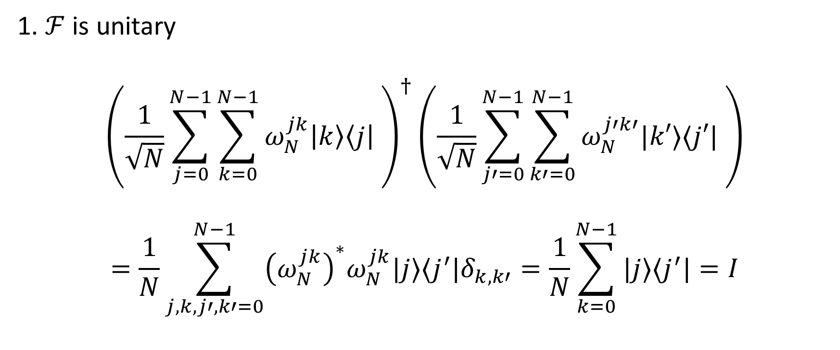
5.1. Quantum Fourier transform
1. $ℱ$ is unitary
$${\left(\frac{1}{\sqrt{N}}\sum_{j=0}^{N−1}{\sum_{k=0}^{N−1}{ω_{N}^{jk}\left|k\right\rangle \left\langle j\right|} }\right)}^{†}\left(\frac{1}{\sqrt{N}}\sum_{j′=0}^{N−1}{\sum_{k′=0}^{N−1}{ω_{N}^{j′k′}|k′⟩⟨j′|} }\right)$$
$$=\frac{1}{N}\sum_{j,k,j′,k′=0}^{N−1}{{\left(ω_{N}^{jk}\right)}^{∗}ω_{N}^{jk}|j⟩⟨j^{′}|δ_{k,k′}=\frac{1}{N}\sum_{k=0}^{N−1}{|j⟩⟨j^{′}|=I}}$$
Notes:
1 + 1 + … = N

Slide 9
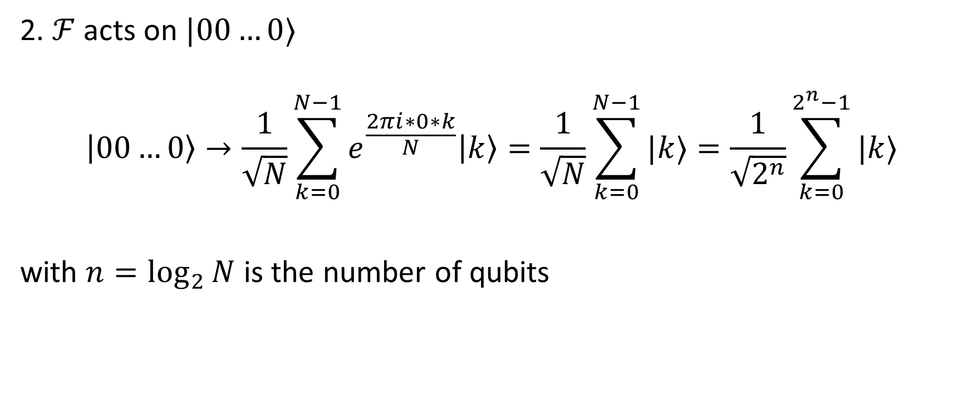
5.1. Quantum Fourier transform
2. $ℱ$ acts on $|00…0⟩$
$$\left|00…0\right\rangle →\frac{1}{\sqrt{N}}\sum_{k=0}^{N−1}{e^{\frac{2πi∗0∗k}{N}}\left|k\right\rangle =\frac{1}{\sqrt{N}}\sum_{k=0}^{N−1}{|k⟩}}=\frac{1}{\sqrt{2^{n}}}\sum_{k=0}^{2^{n}−1}{|k⟩}$$
with $n=\log_{2}{N}$ is the number of qubits

Slide 10

5.1. Quantum Fourier transform
Intuition:
$$ℱ:\left|State in computation basis\right\rangle →|State in Fourier basis⟩$$
$$U_{QFT}\left|x\right\rangle =|\tilde{x}⟩$$
$|\tilde{x}⟩$ denotes for the state in Fourier basis

Slide 11
Computation basis
Fourier basis

Slide 12
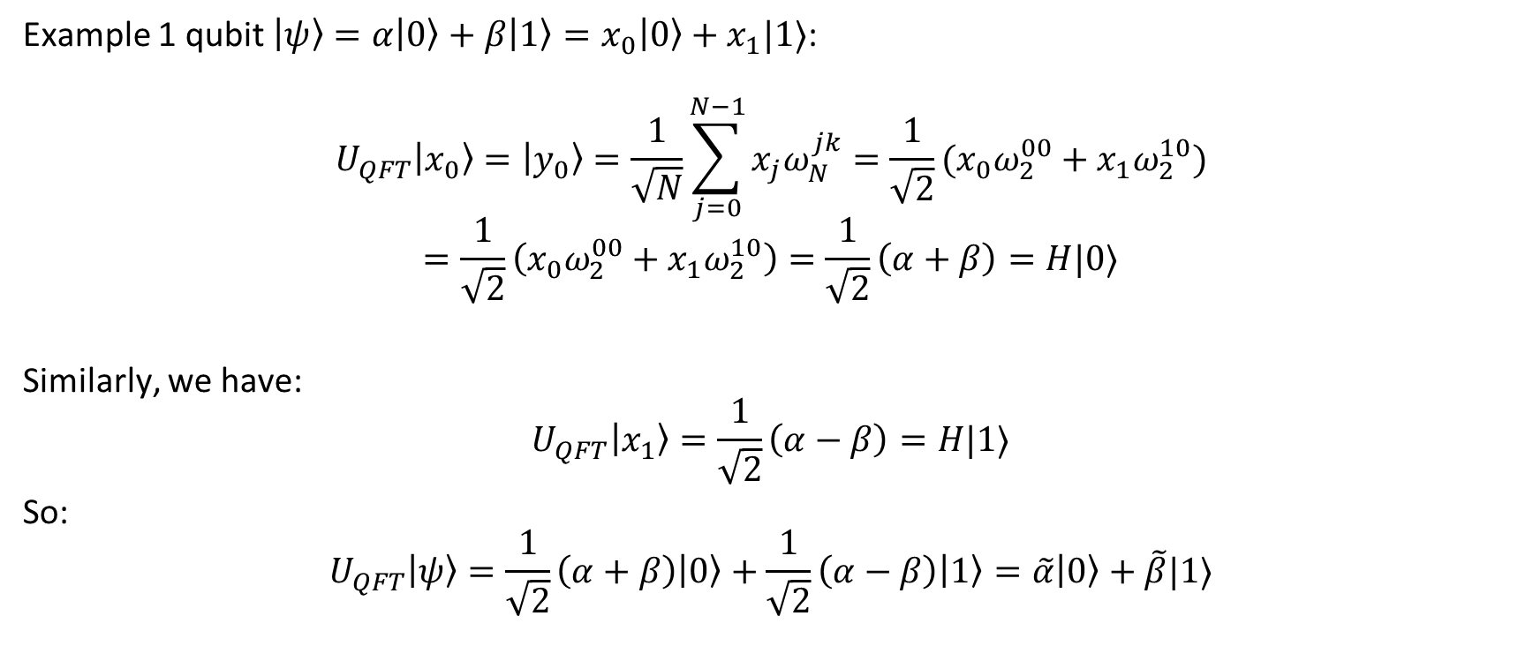
5.1. Quantum Fourier transform
Example 1 qubit $\left|ψ\right\rangle =α\left|0\right\rangle +β\left|1\right\rangle =x_{0}\left|0\right\rangle +x_{1}|1⟩$:
$$U_{QFT}\left|x_{0}\right\rangle =\left|y_{0}\right\rangle =\frac{1}{\sqrt{N}}\sum_{j=0}^{N−1}{x_{j}ω_{N}^{jk}}=\frac{1}{\sqrt{2}}(x_{0}ω_{2}^{00}+x_{1}ω_{2}^{10})$$
$$=\frac{1}{\sqrt{2}}\left(x_{0}ω_{2}^{00}+x_{1}ω_{2}^{10}\right)=\frac{1}{\sqrt{2}}\left(α+β\right)=H|0⟩$$
Similarly, we have:
$$U_{QFT}\left|x_{1}\right\rangle =\frac{1}{\sqrt{2}}\left(α−β\right)=H|1⟩$$
So:
$$U_{QFT}\left|ψ\right\rangle =\frac{1}{\sqrt{2}}\left(α+β\right)\left|0\right\rangle +\frac{1}{\sqrt{2}}\left(α−β\right)\left|1\right\rangle =\tilde{α}\left|0\right\rangle +\tilde{β}|1⟩$$

Slide 13
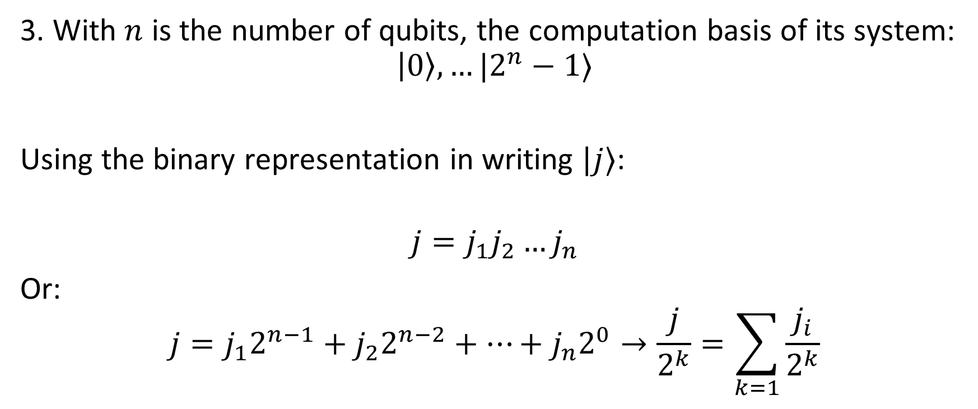
5.1. Quantum Fourier transform
3. With $n$ is the number of qubits, the computation basis of its system:
$$\left|0\right\rangle ,…|2^{n}−1⟩$$
Using the binary representation in writing $|j⟩$:
$$j=j_{1}j_{2}…j_{n}$$
Or:
$$j=j_{1}2^{n−1}+j_{2}2^{n−2}+…+j_{n}2^{0}→\frac{j}{2^{k}}=\sum_{k=1}{\frac{j_{i}}{2^{k}}}$$

Slide 14
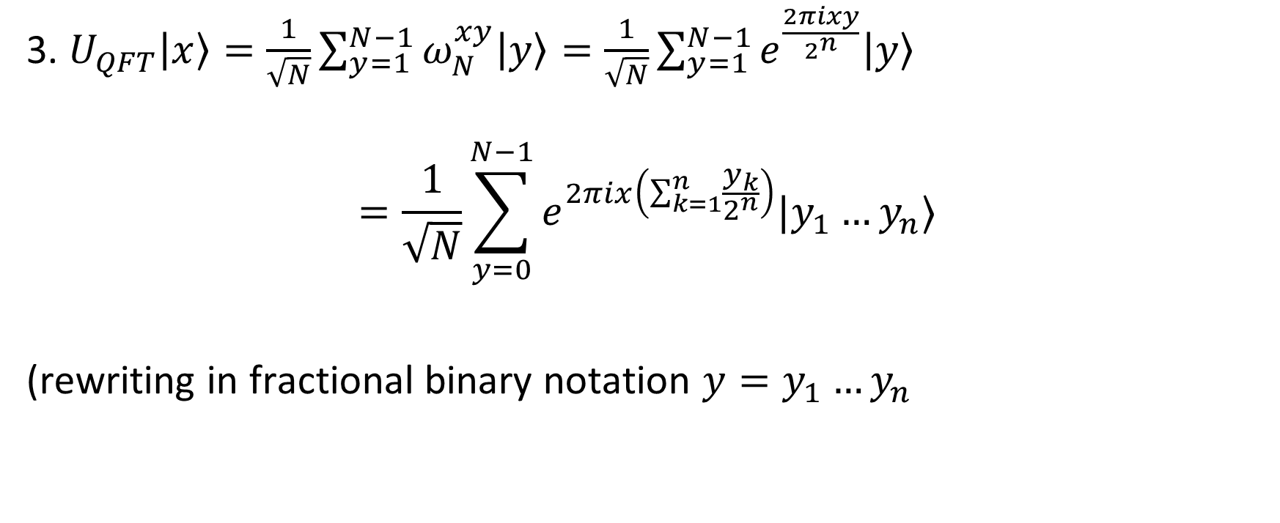
5.1. Quantum Fourier transform
3. $U_{QFT}\left|x\right\rangle =\frac{1}{\sqrt{N}}\sum_{y=1}^{N−1}{ω_{N}^{xy}\left|y\right\rangle =\frac{1}{\sqrt{N}}\sum_{y=1}^{N−1}{e^{\frac{2πixy}{2^{n}}}\left|y\right\rangle }}$
$$=\frac{1}{\sqrt{N}}\sum_{y=0}^{N−1}{e^{2πix\left(\sum_{k=1}^{n}{\frac{y_{k}}{2^{n}}}\right)}|y_{1}…y_{n}⟩}$$
(rewriting in fractional binary notation $y=y_{1}…y_{n}$

Slide 15
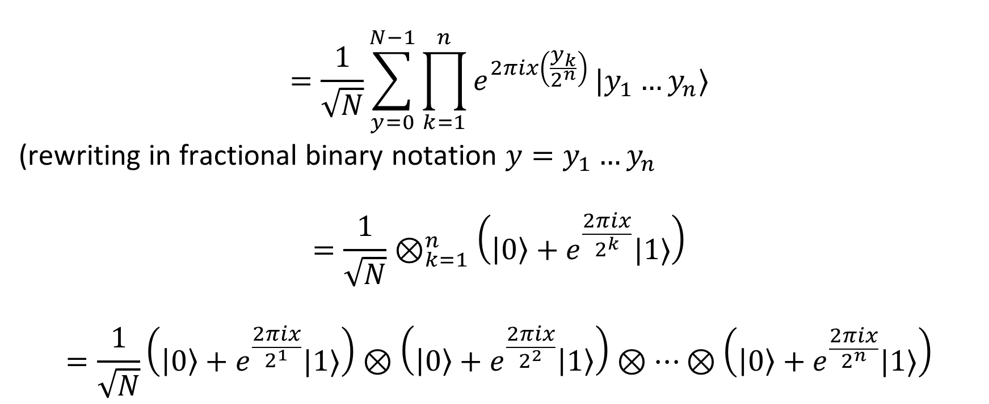
5.1. Quantum Fourier transform
$$=\frac{1}{\sqrt{N}}\sum_{y=0}^{N−1}{\prod_{k=1}^{n}{e^{2πix\left(\frac{y_{k}}{2^{n}}\right)}}|y_{1}…y_{n}⟩}$$
(rewriting in fractional binary notation $y=y_{1}…y_{n}$
$$=\frac{1}{\sqrt{N}}⊗_{k=1}^{n}\left(\left|0\right\rangle +e^{\frac{2πix}{2^{k}}}|1⟩\right)$$
$$=\frac{1}{\sqrt{N}}\left(\left|0\right\rangle +e^{\frac{2πix}{2^{1}}}|1⟩\right)⊗\left(\left|0\right\rangle +e^{\frac{2πix}{2^{2}}}\left|1\right\rangle \right)⊗…⊗\left(\left|0\right\rangle +e^{\frac{2πix}{2^{n}}}|1⟩\right)$$

Slide 16
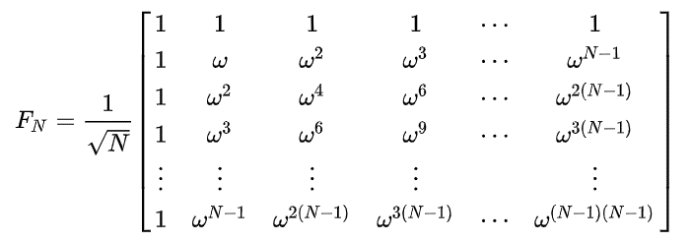
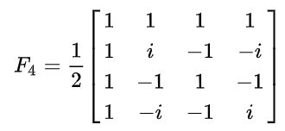
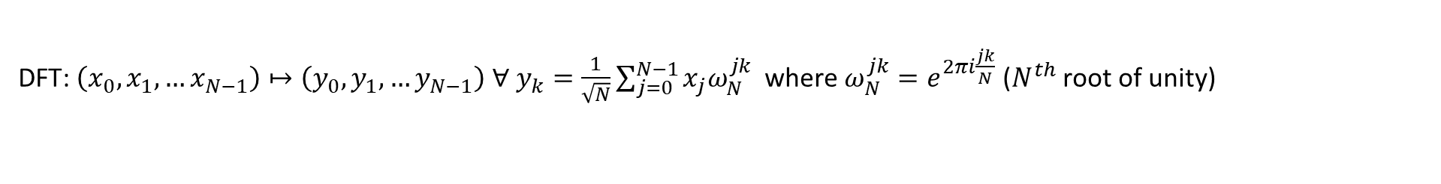
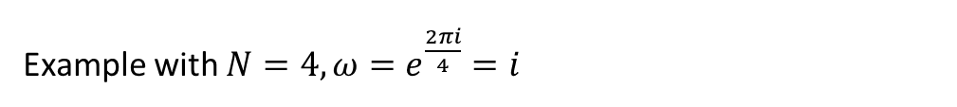
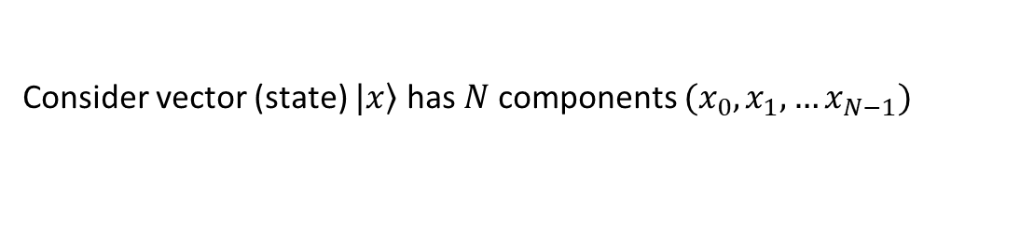
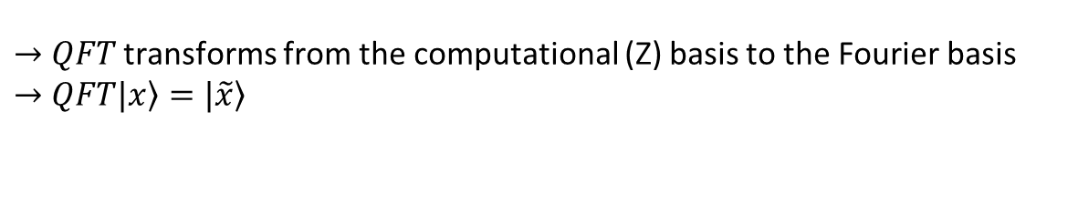
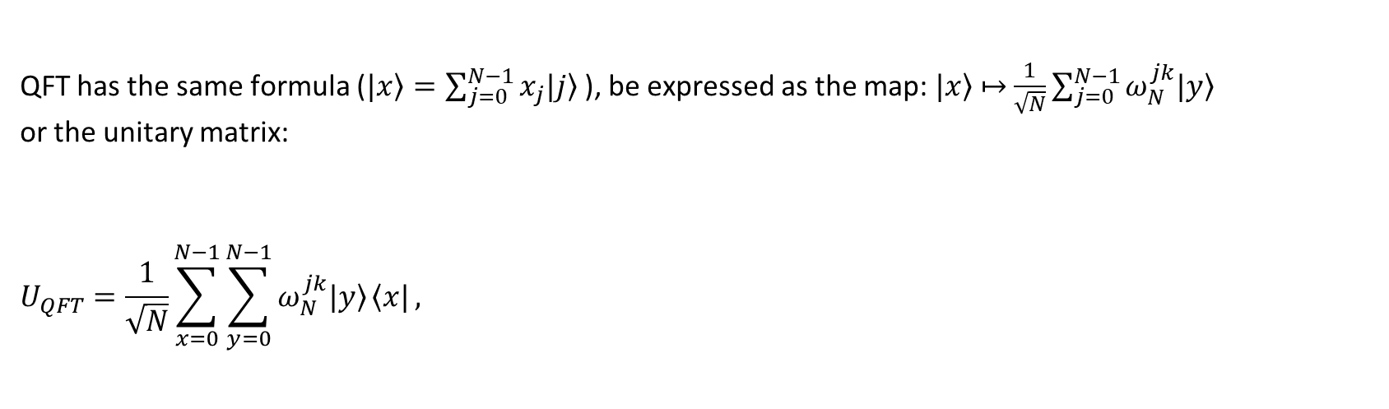
Consider vector (state) $\left.|x\right\rangle$ has $N$ components $(x_{0},x_{1},…x_{N−1})$
DFT: $\left(x_{0},x_{1},…x_{N−1}\right)↦\left(y_{0},y_{1},…y_{N−1}\right) ∀ y_{k}=\frac{1}{\sqrt{N}}\sum_{j=0}^{N−1}{x_{j}ω_{N}^{jk} }$ where $ω_{N}^{jk}=e^{2πi\frac{jk}{N}}$ ($N^{th}$ root of unity)
QFT has the same formula ($\left.|x\right\rangle =\sum_{j=0}^{N−1}{x_{j}\left.|j\right\rangle }$), be expressed as the map:$\left.|x\right\rangle$ $↦$ $\frac{1}{\sqrt{N}}\sum_{j=0}^{N−1}{ω_{N}^{jk}\left.|y\right\rangle }$
or the unitary matrix:
$$U_{QFT}=\frac{1}{\sqrt{N}}\sum_{x=0}^{N−1}{\sum_{y=0}^{N−1}{ω_{N}^{jk}\left.|y\right\rangle }\left\langle x|\right.},$$
Example with $N=4, ω=e^{\frac{2πi}{4}}=i$
$→$ $QFT$ transforms from the computational (Z) basis to the Fourier basis
$→$ $QFT\left.|x\right\rangle =\left.|\tilde{x}\right\rangle$

Slide 17
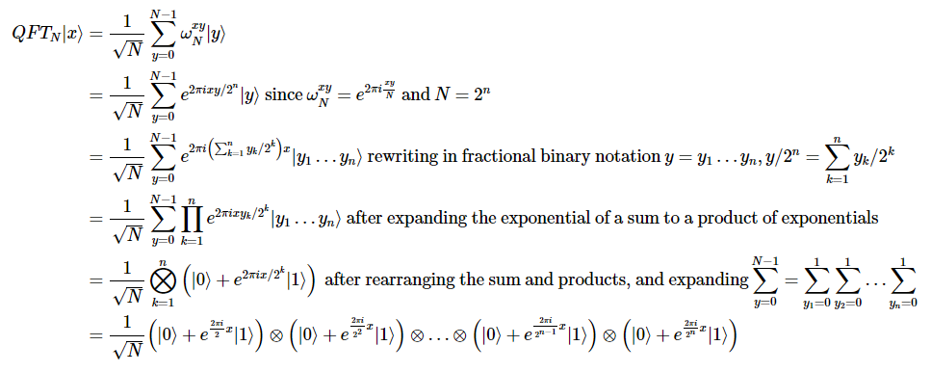

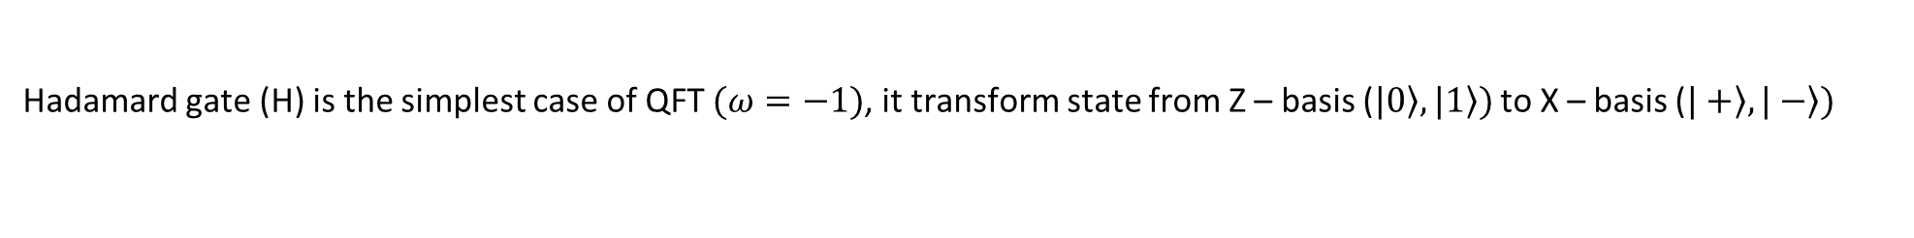
Hadamard gate (H) is the simplest case of QFT $(ω=−1)$, it transform state from Z – basis ($\left.|0\right\rangle ,\left.|1\right\rangle )$ to X – basis ($\left.|+\right\rangle ,\left.|−\right\rangle )$
Consider state $\left.|ψ\right\rangle =α\left.|0\right\rangle +β\left.|1\right\rangle$ ($x_{0}=α, x_{1}=β,N=2)$
$$y_{0}=\frac{1}{\sqrt{2}}\left(αe^{2πi\frac{0x0}{2}}+βe^{2πi\frac{1x0}{2}}\right)=\frac{1}{\sqrt{2}}(α+β)$$
$$y_{1}=\frac{1}{\sqrt{2}}\left(αe^{2πi\frac{0x1}{2}}+βe^{2πi\frac{1x1}{2}}\right)=\frac{1}{\sqrt{2}}(α−β)$$
$$U_{QFT}\left.|ψ\right\rangle =\frac{1}{\sqrt{2}}\left(α+β\right)\left.|0\right\rangle +\frac{1}{\sqrt{2}}\left(α−β\right)\left.|1\right\rangle$$

Slide 18
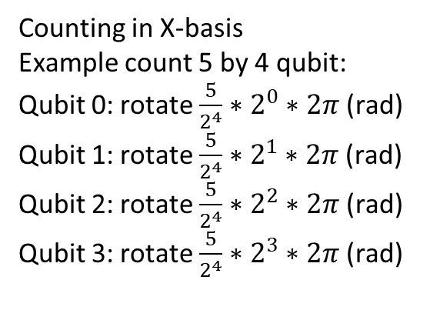
What QFT used for?
Counting in Z-basis seems like to classical computing
Counting in X-basis
Example count 5 by 4 qubit:
Qubit 0: rotate $\frac{5}{2^{4}}∗2^{0}∗2π$ (rad)
Qubit 1: rotate $\frac{5}{2^{4}}∗2^{1}∗2π$ (rad)
Qubit 2: rotate $\frac{5}{2^{4}}∗2^{2}∗2π$ (rad)
Qubit 3: rotate $\frac{5}{2^{4}}∗2^{3}∗2π$ (rad)

Slide 19
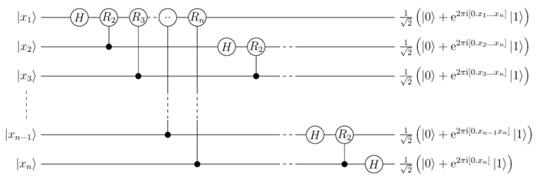
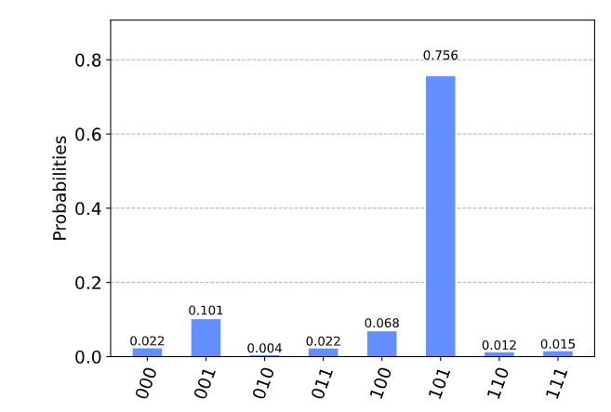
Read out the phases

Slide 20
3. Quantum Phase Estimation

Slide 21
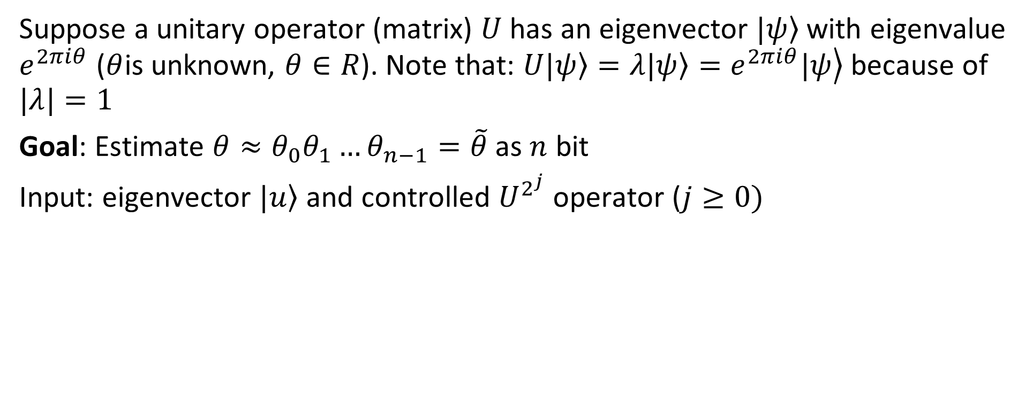
Suppose a unitary operator (matrix) $U$ has an eigenvector $\left.|ψ\right\rangle$ with eigenvalue $e^{2πiθ}$ ($θ$is unknown, $θ∈R$). Note that: $U\left.|ψ\right\rangle =λ\left.|ψ\right\rangle =\left.e^{2πiθ}|ψ\right\rangle$ because of $|λ|=1$
Goal: Estimate $θ≈θ_{0}θ_{1}…θ_{n−1}=\tilde{θ}$ as $n$ bit
Input: eigenvector $\left.|u\right\rangle$ and controlled $U^{2^{j}}$ operator ($j≥0)$

Slide 22
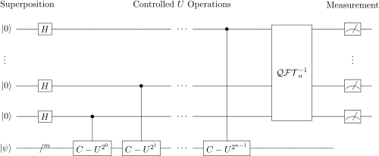
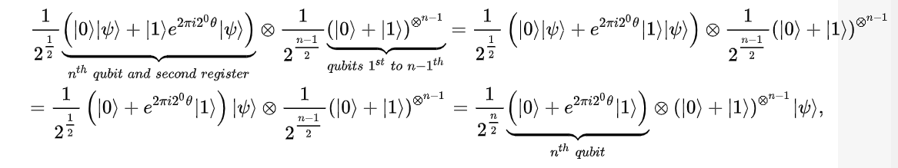
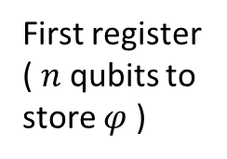
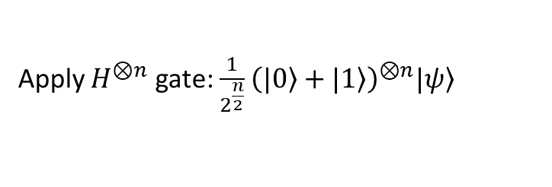
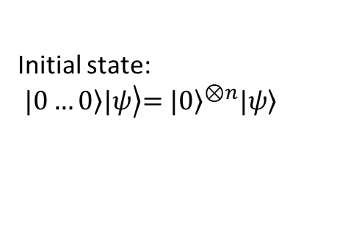
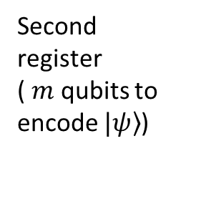
Initial state:
$$\left.\left.|0…0\right\rangle |ψ\right\rangle {\left.=|0\right\rangle }^{⊗n}\left.|ψ\right\rangle$$
First register
( $n$ qubits to store $φ$ )
Second register
( $m$ qubits to encode $\left.|ψ\right\rangle$)
Apply $H^{⊗n}$ gate:$\frac{1}{2^{\frac{n}{2}}}{\left(\left.|0\right\rangle +\left.|1\right\rangle \right)}^{⊗n}\left.|ψ\right\rangle$
Apply controlled unitary operations

Slide 23
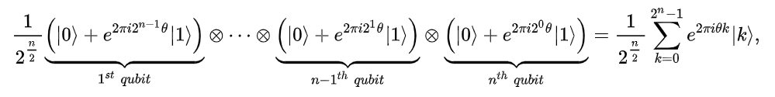
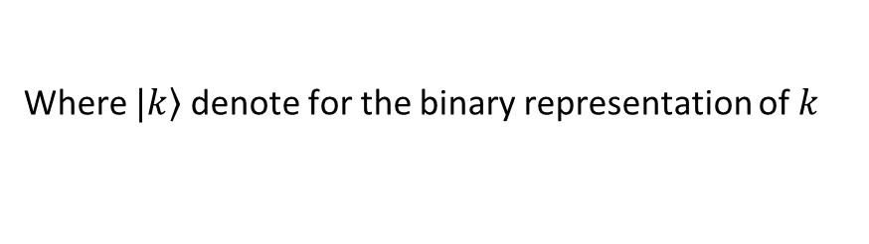
Initial state:
$$\left.\left.|0…0\right\rangle |ψ\right\rangle {\left.=|0\right\rangle }^{⊗n}\left.|ψ\right\rangle$$
First register
( $n$ qubits to store $φ$ )
Second register
( $m$ qubits to encode $\left.|ψ\right\rangle$)
Apply controlled unitary operations
Where $\left.|k\right\rangle$ denote for the binary representation of $k$

Slide 24
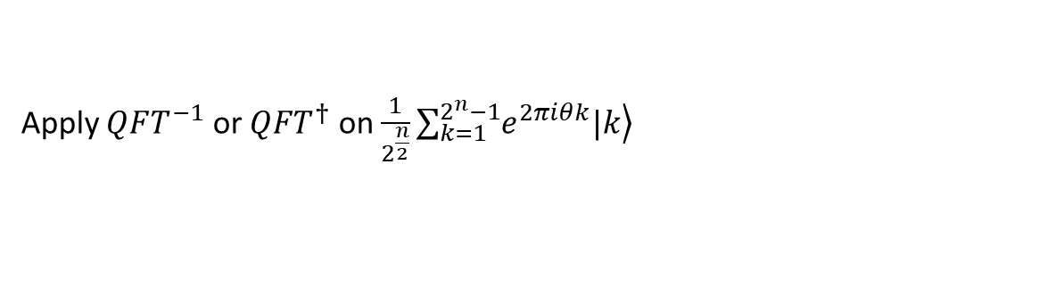
Initial state:
$$\left.\left.|0…0\right\rangle |ψ\right\rangle {\left.=|0\right\rangle }^{⊗n}\left.|ψ\right\rangle$$
First register
( $n$ qubits to store $φ$ )
Second register
( $m$ qubits to encode $\left.|ψ\right\rangle$)
Apply $QFT^{−1}$ or $QFT^{†}$ on $\frac{1}{2^{\frac{n}{2}}}\sum_{k=1}^{2^{n}−1}{\left.e^{2πiθk}|k\right\rangle }$
Yields:

Slide 25
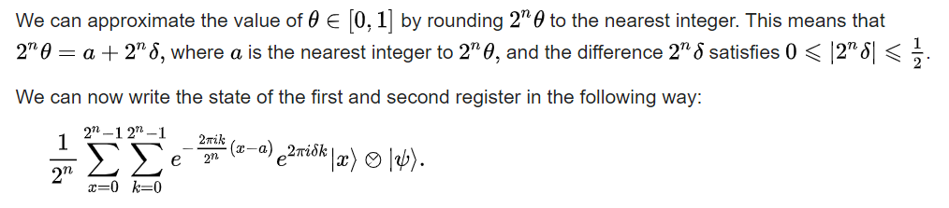
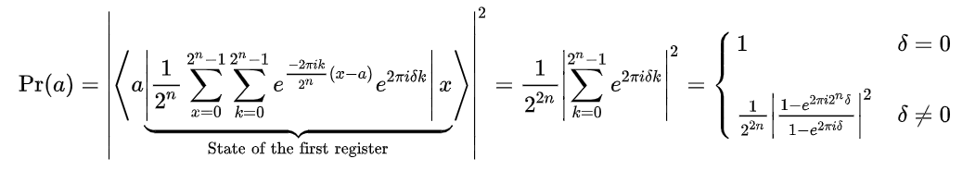

Slide 26
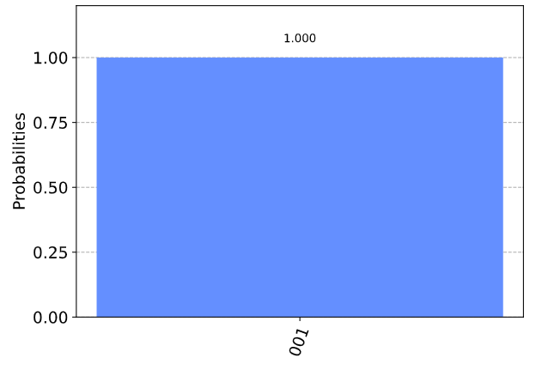
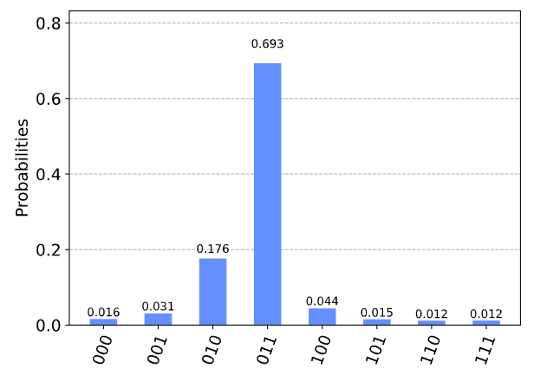

When $θ=\frac{{001}_{2}}{2^{n}}=1/8$
we see our most likely results are 010(bin) = 2(dec) and 011(bin) = 3(dec). These two results would tell us that θ = 0.25 (off by 25%) and θ = 0.375 (off by 13%) respectively

Slide 27
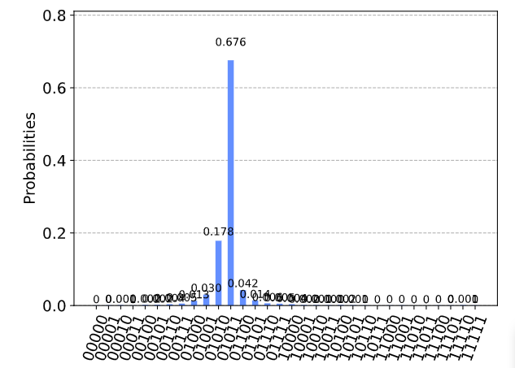
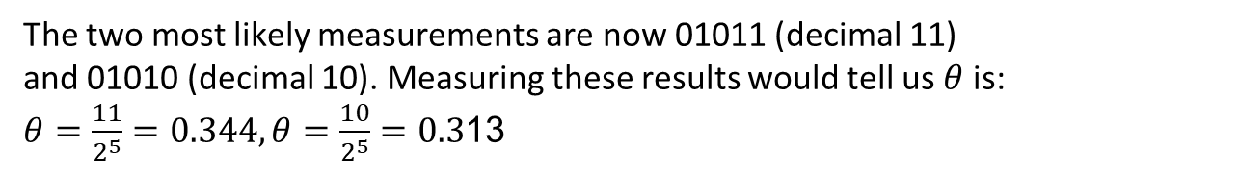
The two most likely measurements are now 01011 (decimal 11) and 01010 (decimal 10). Measuring these results would tell us $θ$ is:
$θ=\frac{11}{2^{5}}=0.344,θ=\frac{10}{2^{5}}=0.3$13

Slide 28
Solving large linear system of equations by HHL Algorithm
20/2/2021

Slide 29
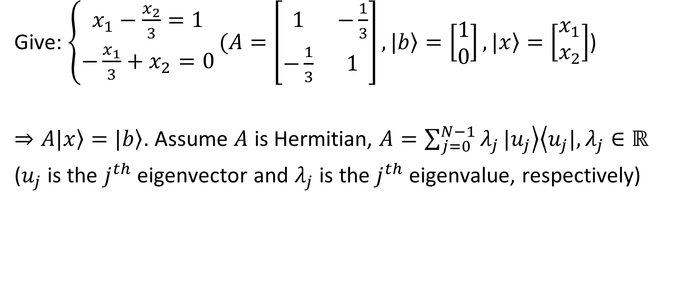
1. Introduction
Give: $\left\{\begin{aligned}x_{1}−\frac{x_{2}}{3}=1 \\ −\frac{x_{1}}{3}+x_{2}=0\end{aligned}\right.(A=\left[\begin{matrix}1 & −\frac{1}{3} \\ −\frac{1}{3} & 1\end{matrix}\right], \left.|b\right\rangle =\left[\begin{matrix}1 \\ 0\end{matrix}\right],\left.|x\right\rangle =\left[\begin{matrix}x_{1} \\ x_{2}\end{matrix}\right]$)
$⇒A\left.|x\right\rangle =\left.|b\right\rangle$. Assume $A$ is Hermitian, $A=\sum_{j=0}^{N−1}{λ_{j}}\left.|u_{j}\right\rangle \left\langle u_{j}|\right., λ_{j}∈ℝ$
($u_{j}$ is the $j^{th}$ eigenvector and $λ_{j}$ is the $j^{th}$ eigenvalue, respectively)

Slide 30
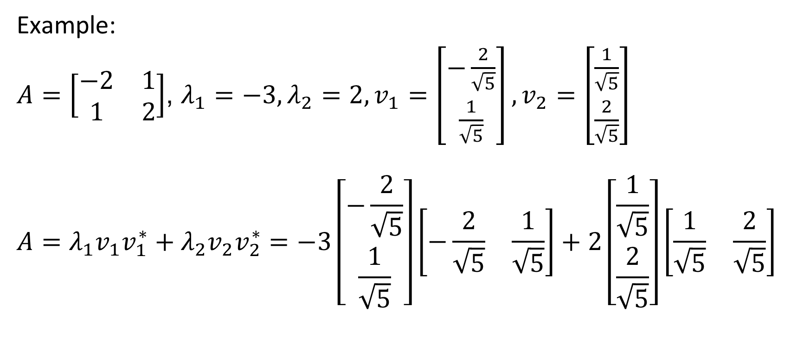
1. Introduction
Example:
$A=\left[\begin{matrix}−2 & 1 \\ 1 & 2\end{matrix}\right]$, $λ_{1}=−3,λ_{2}=2,v_{1}=\left[\begin{matrix}−\frac{2}{\sqrt{5}} \\ \frac{1}{\sqrt{5}}\end{matrix}\right],v_{2}=\left[\begin{matrix}\frac{1}{\sqrt{5}} \\ \frac{2}{\sqrt{5}}\end{matrix}\right]$
$$A=λ_{1}v_{1}v_{1}^{∗}+λ_{2}v_{2}v_{2}^{∗}=−3\left[\begin{matrix}−\frac{2}{\sqrt{5}} \\ \frac{1}{\sqrt{5}}\end{matrix}\right]\left[\begin{matrix}−\frac{2}{\sqrt{5}} & \frac{1}{\sqrt{5}}\end{matrix}\right]+2\left[\begin{matrix}\frac{1}{\sqrt{5}} \\ \frac{2}{\sqrt{5}}\end{matrix}\right]\left[\begin{matrix}\frac{1}{\sqrt{5}} & \frac{2}{\sqrt{5}}\end{matrix}\right]$$

Slide 31

1. Introduction
Then:
$$A^{−1}=\sum_{j=0}^{N−1}{λ_{j}^{−1}}\left.|u_{j}\right\rangle \left\langle u_{j}|\right., \left.|b\right\rangle =\sum_{j=0}^{N−1}{b_{j}}\left.|u_{j}\right\rangle$$
$$⇒\left.|x\right\rangle =A^{−1}\left.|b\right\rangle =\sum_{j=0}^{N−1}{{λ_{j}^{−1}b}_{j}}\left.|u_{j}\right\rangle$$

Slide 32



2. HHL Algorithm
Load eigenvalue of $A$
Ancilla bit
Load $\left.|b\right\rangle$

Slide 33



3. Run on qiskit
Approximate t
Norm 2 between 2 solutions
Exactly t

Slide 34




1. 3 GB RAM
3.9 GB RAM
$$RAM≈0.5 ∗ 2^{\frac{N}{2}} (GB)$$
$$EX_{TIME}≈x∗2^{\frac{N}{2}} (s)$$

Slide 35


5000 x 5000 matrix solving by classical computer
5000 x 5000 matrix solving by quantum simulation require:
$$RAM≈0.5 ∗ 2^{\frac{log2(5000)}{2}} (GB)=35 (GB)$$
$$EX_{TIME}≈x∗2^{\frac{\log{2\left(5000\right)}}{2}} \left(s\right)$$

Slide 36
Summary HHL
Quantum phase estimation (QPE)
Phase kickback
Quantum Fourier transform (QFT)
Inverse of QPE

Slide 37

Questions
1. What ancilla qubits used for?
Store output
Padding for higher order gate with use less component than normal

Slide 38
Questions
How many iterations needed?
Common time?
The relationship between size of input (n) and number of qubits

Slide 39
Quantum search algothrithm
By Lov Grover 1995

Slide 40


1. Problem
Given an unordered array of $m$ elements, find a particular element $x$.
Classical: brute-force requires $m$ queries (average $\frac{m}{2}$)
Quantum: grover’s algothrithm requires $√m$

Slide 41


Slide 42

2. Algothrithm
Imagine that you are given a function $f:{\left\{0, 1\right\}}^{n}→\{0, 1\}$and you are assured that there exists exactly one binary string $x_{0}$ such that:
$$f_{0}=\left\{\begin{aligned}1,if x=x_{0} \\ 0, if x≠x_{0}\end{aligned}\right.$$
Assume $f$ is a unitary matrix $U_{f}$ that take $\left.|x,y\right\rangle$ to $\left.|x,f(x)⊕y\right\rangle$

Slide 43


2. Algothrithm
$$n=2, x_{0}=10$$

Slide 44


2. Algothrithm

Slide 45



3. Example
$$N=3, x_{0}=101$$
Initial state: (1)
After apply $H^{⊕N}$ (2):

Slide 46


3. Example
After apply Phase inversion: (3a)
Calculate average of all elements in $\left.|φ_{3a}\right\rangle$ (3a)

Slide 47




Slide 48




3. Example (iteration 1)
$$→$$
After phase inversion

Slide 49





3. Example (iteration 2)
Remember that we need to repeat step 3 $√(2^{n})$ to achieve state $\left.|φ_{3b}\right\rangle$
$$→$$

Slide 50


3. Example
$$→$$
Measure:
$$p\left(\left.|101\right\rangle \right)={\left(\frac{11}{4\sqrt{8}}\right)}^{2}=0.9453=94.53\%$$
$$p\left(\left.|other\right\rangle \right)=\frac{{\left(\frac{−1}{4\sqrt{8}}\right)}^{2}}{7}=0.0078=0.78\%$$

Slide 51


Slide 52




$$x_{0}=101 \& 110$$

Slide 53


Excute on real device
$$x_{0}=0110 \& 1001$$

Slide 54
Quantum walk
4/3/2022
Vu Tuan Hai

Slide 55


Random walk
Take the random variable $Z∈\{−1, 1\}$
The series ${\{S}_{n}\}$ is a 1-D random walk with $S_{0}=0$ and $S_{n}=\sum_{i=1}^{n}{Z_{i}}$

Slide 56


Random walk
Values of ${\{S}_{N}\}$
Normal distribution of $S_{N}$
More likely
Unlikely

Slide 57




Quantum walk (using superposition)
Incre $↑$
Decre $↓$
$$\left|000\right\rangle →\left|001\right\rangle$$
$$\left|010\right\rangle →|011⟩$$
…
H
$$\left|↑\right\rangle ⊗\left|0\right\rangle \underset{→}{H}\frac{1}{\sqrt{2}}(|↑ ⟩+|↓ ⟩)⊗|0⟩\underset{→}{S}\frac{1}{\sqrt{2}}(|↑ ⟩|0⟩+|↓ ⟩⊗|0⟩)$$

Slide 58







Incre $↑$
Decre $↓$
PREP
$${PREP}^{†}$$
$${\left|0\right\rangle }^{⊗n}$$
SELECT
$$\left|000\right\rangle →\left|001\right\rangle$$
$$\left|010\right\rangle →|011⟩$$
…
H
$$|ψ⟩$$
(a)
(b)

Slide 59



Quantum walk
Values of ${\{S}_{N}\}$
Paranormal distribution of $S_{N}$
Unlikely
More likely

Slide 60
Quantum walk
Quantum walk is described as product of 2 unitary operator: coin flip operator & shift operator

Slide 61

1. Spatial search (discrete time)
1
Assume that we have a complete graph with 4 nodes.
One approach is using random walk.
Note that:
Walker must be in somewhere
$$⇒\sum{P_{j}=1}$$
4
2
3

Slide 62





2. Random walk
$$\frac{1}{4}$$
1
Initial state: ¼ at all node
At step k: jump to other random nodes
$P_{1}=P_{2}=P_{3}=P_{4}=1/4$
Acts as absorb node
$$\frac{1}{4}$$
4
2
$$\frac{1}{4}$$
3
$$\frac{1}{4}$$

Slide 63










2. Random walk
$$\frac{1}{12}$$
$$\frac{1}{12}$$
1
At step 1:
$$\frac{1}{12}$$
$$\frac{1}{12}$$
$$\frac{1}{12}$$
4
2
$$\frac{1}{4}$$
$$\frac{1}{12}$$
$$\frac{1}{12}$$
3
$$\frac{1}{12}$$
$$\frac{1}{12}$$

Slide 64





2. Random walk
$$\frac{1}{6}$$
1
When done step 1:
$$P_{1}=P_{3}=P_{4}=\frac{1}{12}∗2 =\frac{1}{6}$$
$$P_{2}=\frac{1}{4}+\frac{1}{12}∗3=1/2$$
$$\frac{1}{6}$$
4
2
$$\frac{1}{2}$$
3
$$\frac{1}{6}$$

Slide 65









2. Random walk
$$\frac{1}{18}$$
$$\frac{1}{18}$$
1
At step 2:
$$\frac{1}{18}$$
$$\frac{1}{18}$$
$$\frac{1}{18}$$
4
2
$$\frac{1}{2}$$
$$\frac{1}{18}$$
$$\frac{1}{18}$$
3
$$\frac{1}{18}$$
$$\frac{1}{18}$$

Slide 66





2. Random walk
$$\frac{1}{9}$$
1
When done step 2:
$P_{1}=P_{3}=P_{4}=\frac{1}{18}∗2=\frac{1}{9}$
$$P_{2}=\frac{1}{2}+\frac{1}{18}∗3=\frac{2}{3}$$
$$\frac{1}{9}$$
4
2
$$\frac{2}{3}$$
3
$$\frac{1}{9}$$

Slide 67









2. Random walk
$$\frac{1}{27}$$
$$\frac{1}{27}$$
1
At step 3:
$$\frac{1}{27}$$
$$\frac{1}{27}$$
$$\frac{1}{27}$$
4
2
$$\frac{2}{3}$$
$$\frac{1}{27}$$
$$\frac{1}{27}$$
3
$$\frac{1}{27}$$
$$\frac{1}{27}$$

Slide 68





2. Random walk
$$\frac{2}{27}$$
1
When done step 3:
$$P_{1}=P_{3}=P_{4}=\frac{1}{27}∗2=\frac{2}{27}$$
$$P\left(2\right)=\frac{2}{3}+\frac{1}{27}∗3=\frac{7}{9}$$
$$\frac{2}{27}$$
4
2
$$\frac{7}{9}$$
3
$$\frac{2}{27}$$

Slide 69


2. Random walk
Prob(Success) at time t = $1−\frac{N−1}{N}{\left(\frac{N−2}{N−1}\right)}^{t}$
Runtime: $O(N)$

Slide 70













3. Quantum walk
$$α_{14}$$
1
$$α_{12}$$
Change 4 probs to 12 amplitudes of a wave function $\left|ψ\right\rangle ≔\{α_{i}\}$
Init: $|ψ(0)⟩$
Note that at intermediate steps we cannot observe the system. Then we do not know the current node is the marked node or not.
$$α_{41}$$
$$α_{21}$$
$$α_{13}$$
4
2
$$α_{42}$$
$$α_{24}$$
$$α_{31}$$
$$α_{43}$$
$$α_{23}$$
3
$$α_{34}$$
$$α_{32}$$

Slide 71














3. Quantum walk
At node 2: A = $\frac{−1}{\sqrt{12}}∗\frac{3}{3}$
$$\frac{1}{\sqrt{12}}$$
$$\frac{1}{\sqrt{12}}$$
1
At step 1
1a. Query oracle:
$$Q|ψ\left(0\right)⟩$$
1b. Apply a quantum coin flip+shift (-I+2A) that inverts each amplitude about the average amplitude at its vertex. (Nothing happen)
$$C(Q|ψ\left(0\right)⟩)$$
$$\frac{1}{\sqrt{12}}$$
$$−\frac{1}{\sqrt{12}}$$
$$\frac{1}{\sqrt{12}}$$
$$\frac{1}{\sqrt{12}}$$
$$−\frac{1}{\sqrt{12}}$$
2
4
$$\frac{1}{\sqrt{12}}$$
$$\frac{1}{\sqrt{12}}$$
$$−\frac{1}{\sqrt{12}}$$
3
$$\frac{1}{\sqrt{12}}$$
$$\frac{1}{\sqrt{12}}$$

Slide 72







3. Quantum walk
$$\frac{1}{\sqrt{12}}$$
$$−\frac{1}{\sqrt{12}}$$
1
1c. Shift operator (walk): walker at vertex i pointing to vertex j to hop to vertex j and point back to vertex i $⇒$ Swap $α_{ij}$ with $α_{ji}$.
$$SCQ\left|ψ\left(0\right)\right\rangle =|ψ\left(1\right)⟩$$
$$\frac{1}{\sqrt{12}}$$
$$\frac{1}{\sqrt{12}}$$
$$−\frac{1}{\sqrt{12}}$$
$$\frac{1}{\sqrt{12}}$$
$$\frac{1}{\sqrt{12}}$$
2
4
$$\frac{1}{\sqrt{12}}$$
$$\frac{1}{\sqrt{12}}$$
$$\frac{1}{\sqrt{12}}$$
3
$$\frac{1}{\sqrt{12}}$$
$$−\frac{1}{\sqrt{12}}$$

Slide 73

3. Quantum walk
$$\frac{1}{\sqrt{12}}$$
$$−\frac{1}{\sqrt{12}}$$
1
At step 2
2a. Query oracle:
$$Q|ψ\left(1\right)⟩$$
$$\frac{1}{\sqrt{12}}$$
$$−\frac{1}{\sqrt{12}}$$
$$−\frac{1}{\sqrt{12}}$$
$$\frac{1}{\sqrt{12}}$$
$$−\frac{1}{\sqrt{12}}$$
2
4
$$\frac{1}{\sqrt{12}}$$
$$\frac{1}{\sqrt{12}}$$
$$−\frac{1}{\sqrt{12}}$$
3
$$\frac{1}{\sqrt{12}}$$
$$−\frac{1}{\sqrt{12}}$$

Slide 74


3. Quantum walk
Reflected amp
2b. The coin inverts or reflects each amplitude about their average.
(-I+2A)
At node 1: $A=\frac{\frac{1}{\sqrt{12}}+\frac{1}{\sqrt{12}}−\frac{1}{\sqrt{12}}}{3}=\frac{1}{6\sqrt{3}}$
$$⇒α_{12}=−α_{12}+2A=\frac{5}{6\sqrt{3}}$$
$$⇒α_{13}=−α_{13}+2A=\frac{−1}{6\sqrt{3}}$$
Current amp

Slide 75













3. Quantum walk
$$\frac{−1}{6\sqrt{3}}$$
$$\frac{5}{6\sqrt{3}}$$
1
2c. Shift operator (walk): swap $α_{ij}$ with $α_{ji}$.
$$\frac{−1}{6\sqrt{3}}$$
$$−\frac{1}{2\sqrt{3}}$$
$$\frac{−1}{6\sqrt{3}}$$
$$−\frac{1}{2\sqrt{3}}$$
4
2
$$\frac{5}{6\sqrt{3}}$$
$$\frac{−1}{6\sqrt{3}}$$
$$\frac{−1}{6\sqrt{3}}$$
$$−\frac{1}{2\sqrt{3}}$$
3
$$\frac{−1}{6\sqrt{3}}$$
$$\frac{5}{6\sqrt{3}}$$

Slide 76











3. Quantum walk
$$\frac{11}{108}$$
$$\frac{−1}{6\sqrt{3}}$$
$$−\frac{1}{2\sqrt{3}}$$
1
2c. Shift operator (walk): swap $α_{ij}$ with $α_{ji}$.
$$\frac{−1}{6\sqrt{3}}$$
$$\frac{5}{6\sqrt{3}}$$
$$−\frac{1}{2\sqrt{3}}$$
$$\frac{−1}{6\sqrt{3}}$$
$$\frac{5}{6\sqrt{3}}$$
2
$$\frac{11}{108}$$
4
$$\frac{25}{36}$$
$$\frac{−1}{6\sqrt{3}}$$
$$\frac{−1}{6\sqrt{3}}$$
$$\frac{5}{6\sqrt{3}}$$
3
$$\frac{−1}{6\sqrt{3}}$$
$$−\frac{1}{2\sqrt{3}}$$
$$\frac{11}{108}$$

Slide 77




3. Quantum walk
Prob(Success) at time t =
Runtime: $O(\sqrt{N})$
N=4
N=100

Slide 78


References
Thomas Wong,
Creighton University

